Slide 1
ÇözümKüpü
WEB-Management and Teacher module

Slide 2
CONTENTS
Constant Values
Questions Banks-PracticesExamSet
Teacher Module
Role
Accounting Management
Support Management
Students-Teacher-Admin Management
Notifications
Settings

Slide 3
1-CONSTANT VALUES
1-Constant values
1.1-Exams
1.3-Book categories
1.4-Lessons
1.5-Topics
1.6- Sub Topics
1.1.1-Point Calculation
1.1.2-Score Ranking
1.2-Exam Fields
1.1.1.0-diploma score calculation constant
1.7-Publisher
1.6.1-Add Question type photo
1.6.2-Add Solve photo of question type
Exam > Exam Fields > Lessons > Topics > Sub Topics

Slide 4
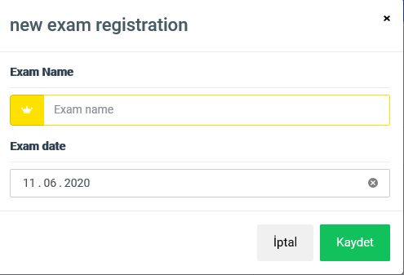
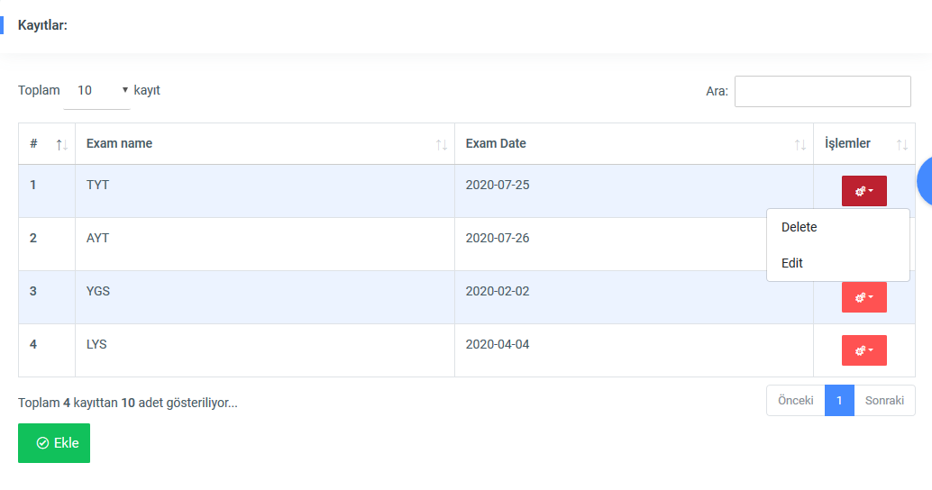
1.1-Exams
Add national university entrance exam
*Exam Name
*Exam date / time
*Added exams will be listed

Slide 5
1.1.1-Point Calculation
1.1.1-Point Calculation
Go To mobile screen page 20-21
OBP Calculation Formula; [OBP= «graduation grade(min:40,max:100)» * «diploma score calculation constant»] Forexample: OBP= 85×0,6=51
(if select on mobilescreen page 20)if registered at a university the previous year; OBP Score divided by half. Forexample: OBP= (85×0,6)/2=25.5
Score Calculation Formula for Courses:
*TYT- («HAM»)
TYT-Türkçe(40-MAXque)*3,107 + TYT-Matematik(40-MAXque)*3,030+ TYT-Sosyal(20-MAXque)*3,728+ TYT-Fen Bilgisi(20-MAXque)*3,49+100 = «HAM» Point
*TYT- («YER»)
«HAM» + «OBP»=«YER»Point
Point constant value of each question in the Lesson
Lessons
ForExample: ((32 - ( 5 / 4 ))*3,107+…….
Point constant value of each question in the Lesson
Constant
Number of Correct Answers
Constant
Number of incorrect Answers
Can calculate for a One Lesson

Slide 6
1.1.1.0-diploma score calculation constant
Edit diploma score calculation constant
**Diploma Score constant
Note: there is a diploma constant, it cannot be added, it can only be edited

Slide 7
1.1.2-Score Ranking
Calculating score ranking for the past years
**First, the student's score is calculated. The ranking closest to the calculated score in the uploaded excel file is determined.
Use Redis
Go to Mobilescreen 21
Calculating score ranking for the past years
Note: this place needs to work very fast. 20,000 data will be scanned for each calculation. You can review excell score ranking

Slide 8
1.2-Exam Fields
Add Exam Fields
*add score calculation exam fields Name
Add excel File(which score is equal to which ranking), first the year of the excel data is added(2016 or 2017..), then the excel data of that year is added.
For example excell file included: 350 point= 2.256 rank, 350.7= 2320rank
*Select exam fields which Lesssons includes (more than one Lessons will be chosen)
Go to mobile screen 21 (TYT-SAY-EA-SOZ-DiL =These are Exam Fields)

Slide 9
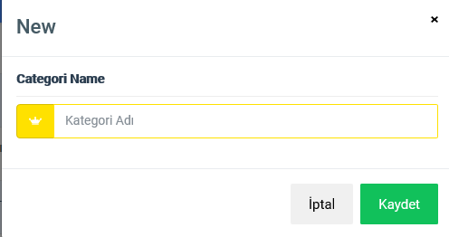
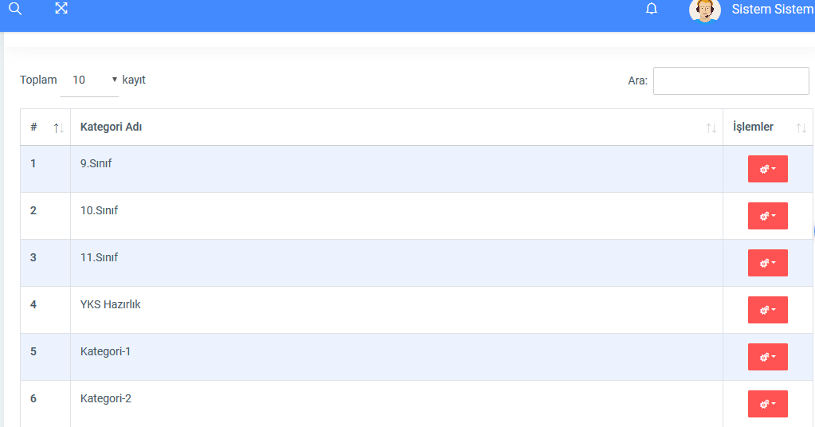
1.3-Book categories
Category Name
Added Category will be listed

Slide 10
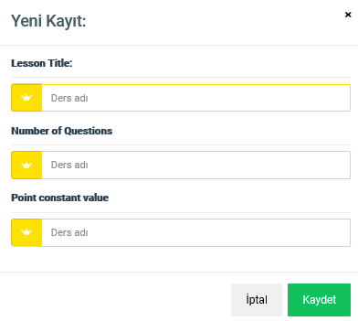
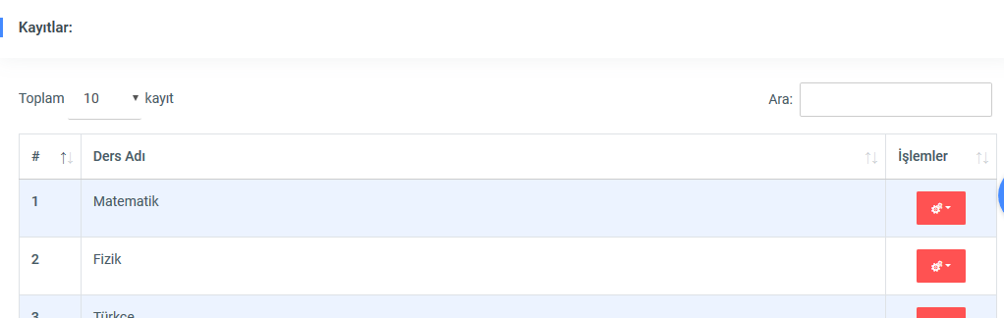
1.4-Lessons
Add Lesson
*Lesson Name
*number of questions asked in the exam
*Point constant value of each question in the Lesson(number Factor)
Added Lesson will be listed

Slide 11
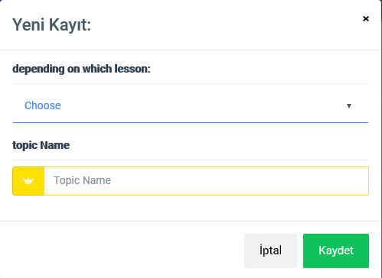
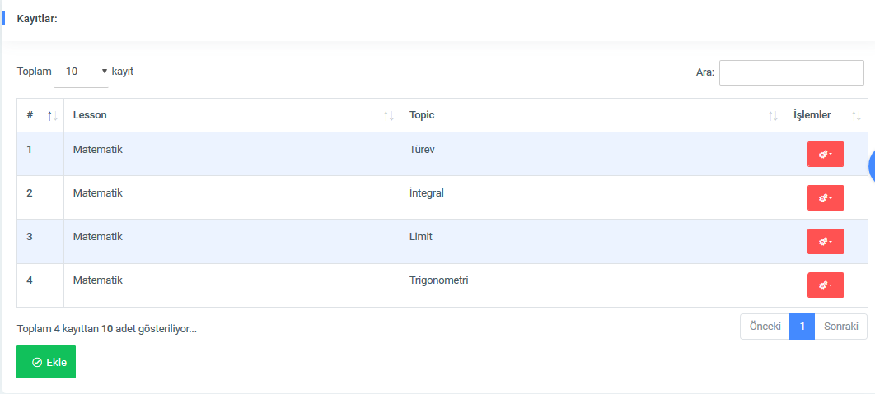
Add Topics
Note: Lesson-topics and subtopics are linked
**Slect Lesson(multiple lessons can be selected for a topic)
**Add topic Name
multiple Topic names can be added at the same time. for adding to be fast. for example, Topic names are separated by commas. Let each Topic look like it was added separately. Like adding a Tag
1.5-Topics

Slide 12
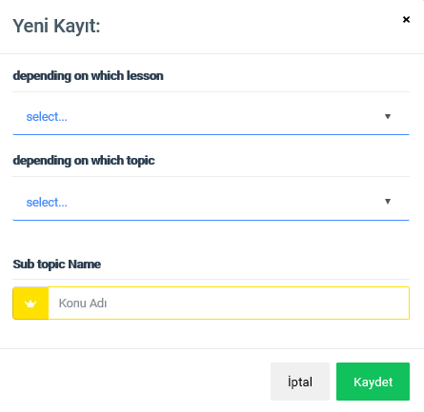
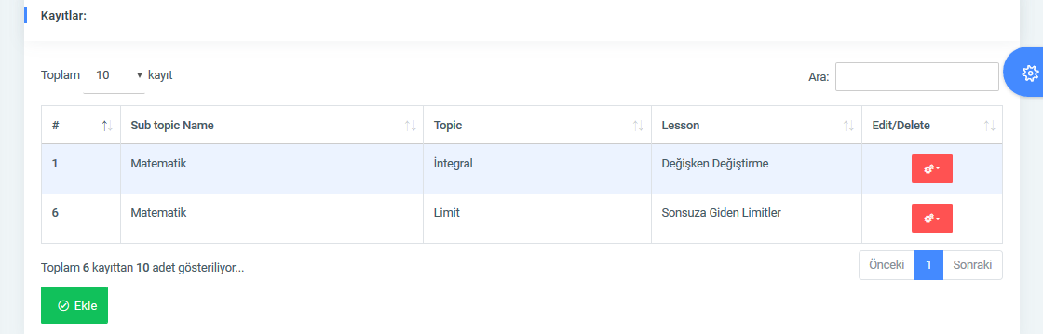
Add SubTopics
Note: Lesson-topics and subtopics are linked
**Slect Lesson
**Select Topic
**Add SubTopic Name
multiple SubTopic names can be added at the same time. for adding to be fast. for example, SubTopic names are separated by commas. Let each SubTopic look like it was added separately. Like adding a Tag
1.6-Sub Topics

Slide 13
1.6.1-Add Question type photo
1.6.1-Add Question type photo
**Sample questions can be added for each subtopic
-multiple questions photo can be added
Go to mobile screen page 62

Slide 14
1.6.2-Add Solve photo of question type
1.6.2-Add Solve photo of question type
**One question solution photo is added for each question photo added
Go to mobile screen page 61

Slide 15
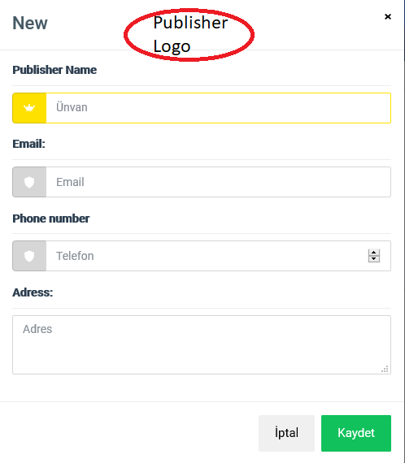
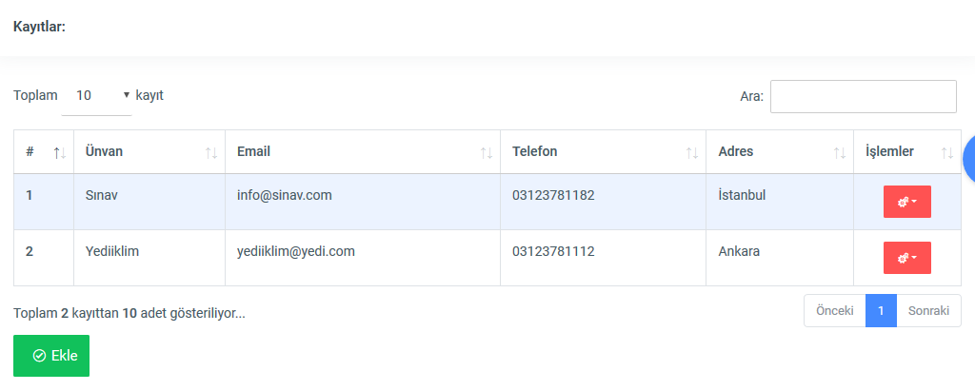
1.7-Publisher
Add Publisher
Publisher Logo:
Publisher Name:
Publisher Email:
Publisher Phone number(9 digit):
Publisher Adress:
Added Publisher will be listed

Slide 16
2-ADD QUESTİONS BANK(BOOK) AND PRACTİCE EXAMS
2-ADD QUESTİONS BANK(BOOK) AND PRACTİCE EXAMS
2.1-QUESTİONS BANK(BOOK)
2.2-PRACTİCE EXAMS
2.1.1-Books
2.1.1.1-Units in the book
2.1.1.1.1-Sections in the unit
2.1.1.1.1.1-Questions Tests
2.2.1-Practices Exam Sets
2.2.1.1-Practices Exam Booklet
2.2.1.1.1-Booklet Tests
Add Answer for Test s
2.1.1.1.1.2
question bank and practice exam set are independent from each other.

Slide 17
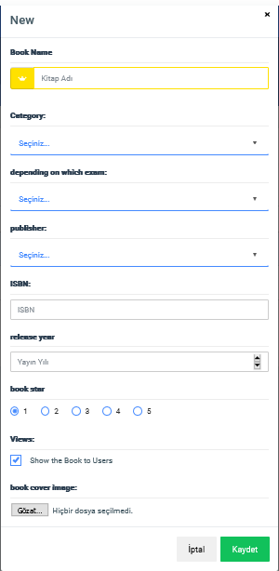
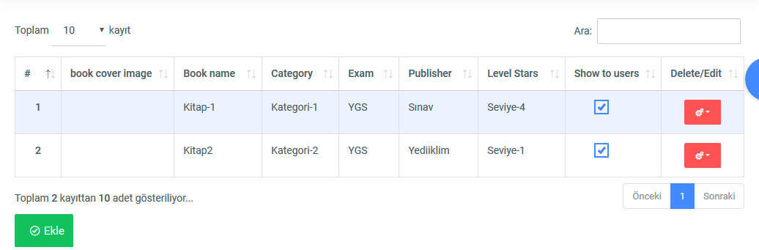
2.1.1-Books
Add-Book
**Book Photo(book photo should be clipped in A4 size. Crop should be)
**Book Name
**select Category
**Select Exam(select more than one) (e.g. “AYT”, “TYT”)
**Select Publisher
**add ISBN no
**add Release Year
**Select Book Level (1 to 10)
** Select Show to Users(users will not see it now, if we want to see it later, we will not mark it. because no more questions and answers have been added)

Slide 18
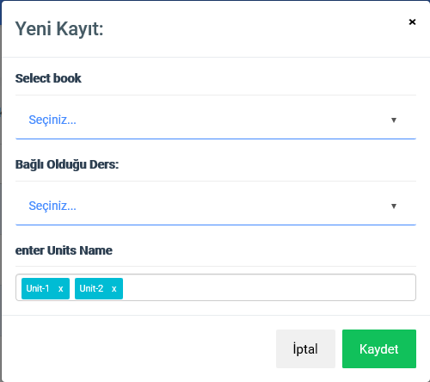
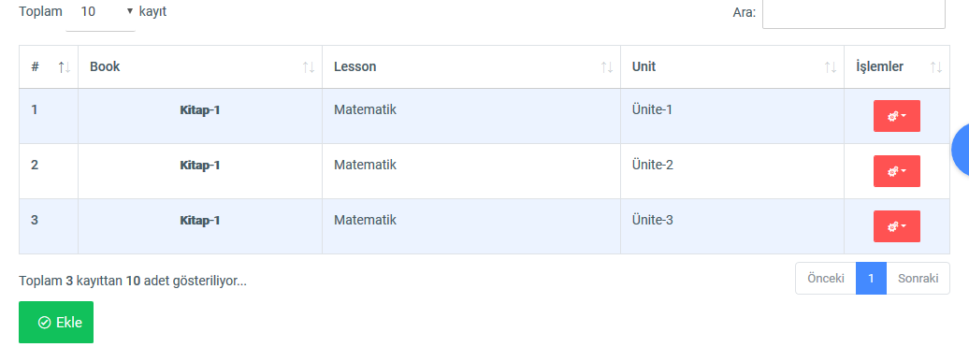
Add-Book Unit
**Select Book
**Select Lesson (e.g. “mathematics”, “history”)
**Add unit Title. (allow multiple Adds at once, just like Tag)
2.1.1.1-Units in the book

Slide 19
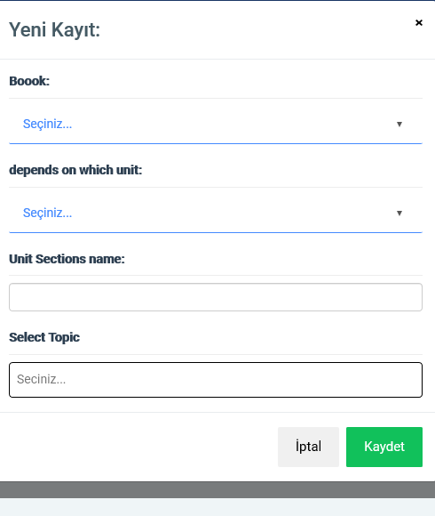
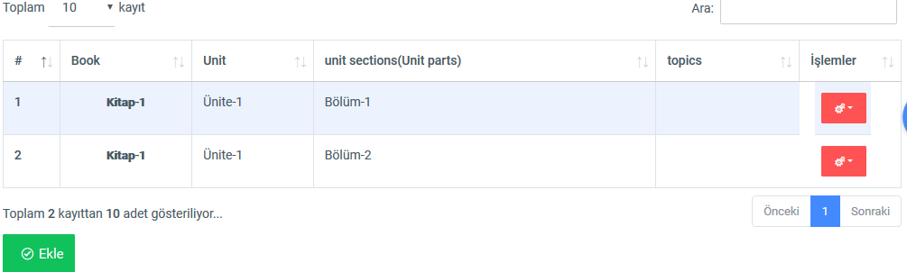
Add-Book Sections Unit
**Select Book
**Select Units
**Select Topic (allow multiple Selections at once. We have added lessons for the unit before. topics related to the lesson below will appear here) (e.g. “derivative”, “integral”)
**Add unit Sections Title. (allow multiple Adds at once, just like Tag)
2.1.1.1.1-Sections in the unit

Slide 20
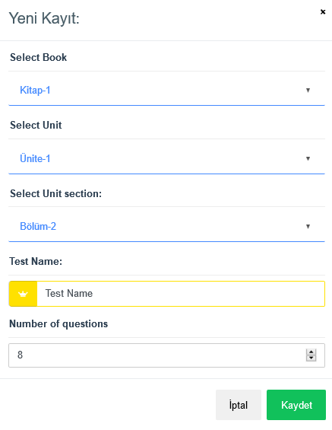
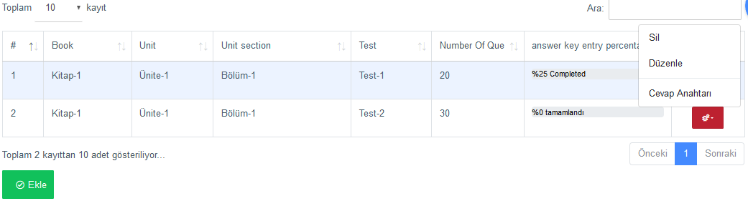
Add-Questions Tests
**Select Book
**Select Units
**Select Unit Section
**Add Test Title
**Number of questions for this test
2.1.1.1.1.1-Questions Tests

Slide 21
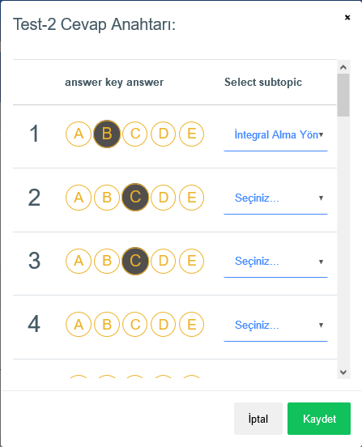
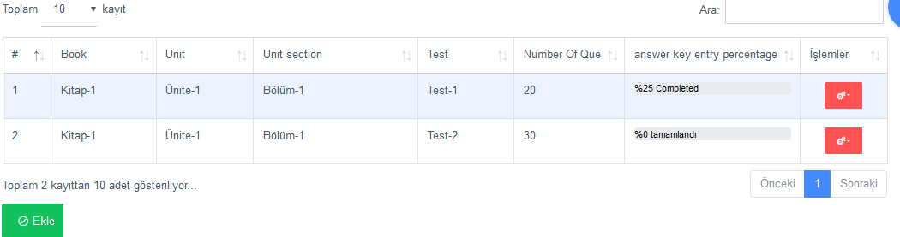
Add Answer for Test s
2.1.1.1.1.2
Add-answers for tests
**mark the correct answer for the question
**the question belongs to which sub-topic(previously selected the topic to which the test was linked. So the subtopics shown here must be subtopics depending on the topics flagged for testing.

Slide 22
2-ADD QUESTİONS BANK(BOOK) AND PRACTİCE EXAMS
2.1-QUESTİONS BANK(BOOK)
2.2-PRACTİCE EXAMS
2.1.1-Books
2.1.1.1-Units in the book
2.1.1.1.1-Sections in the unit
2.1.1.1.1.1-Questions Tests
2.2.1-Practices Exam Sets
2.2.1.1-Practices Exam Booklet
2.2.1.1.1-Booklet Tests
Add Answer for Test s
2.1.1.1.1.2
2.2-PRACTİCE EXAM SETS

Slide 23
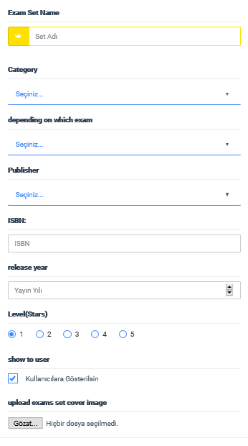
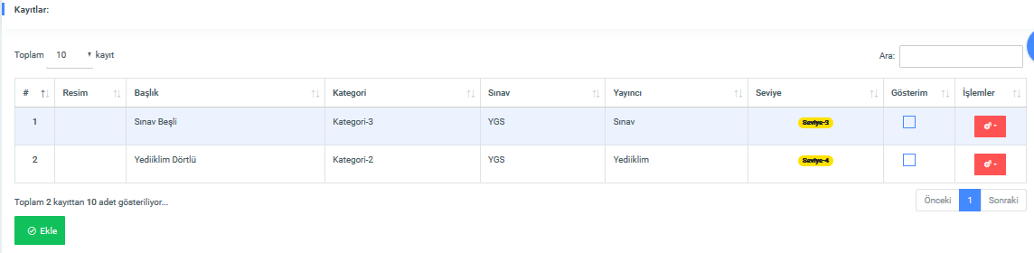
2.2.1-Practices Exam Sets
Add-Practices Exam Sets
**Add Exam set Photo(A4size Crop)
**Add Practices Exam Set Title
**Select Category
**Select Exam
**Select Publisher
**Add ISBN Number
**Release Year
**select Level stars(1 to 10)
**Select,Show To User?

Slide 24
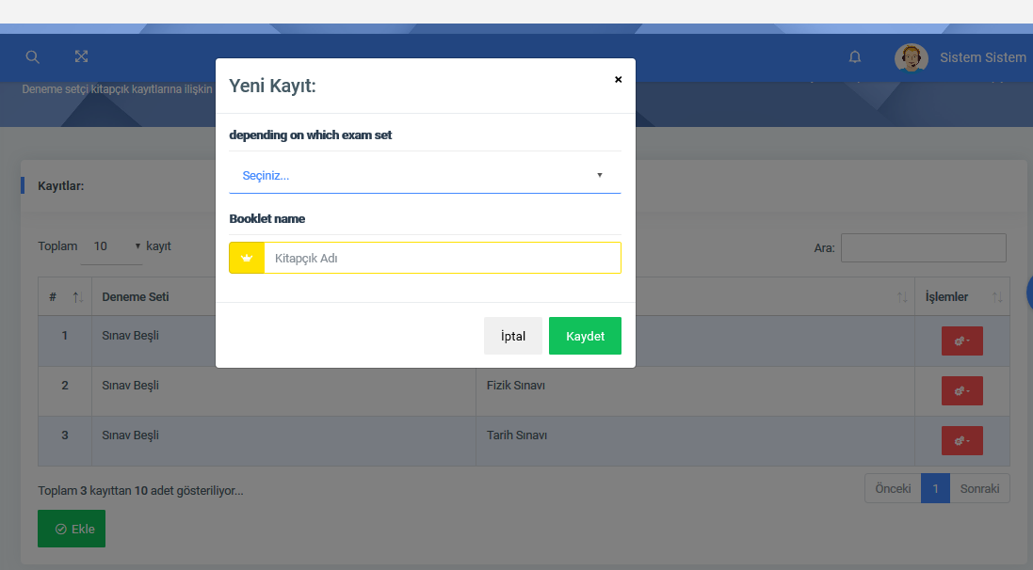
2.2.1.1-Practices Exam Booklet
Add-Practices Exam Booklet
**Select Exam Set
**Add booklet Name

Slide 25
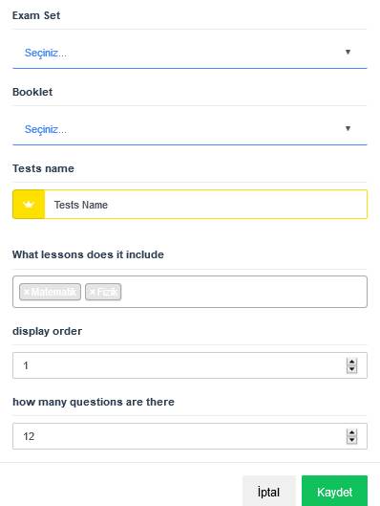
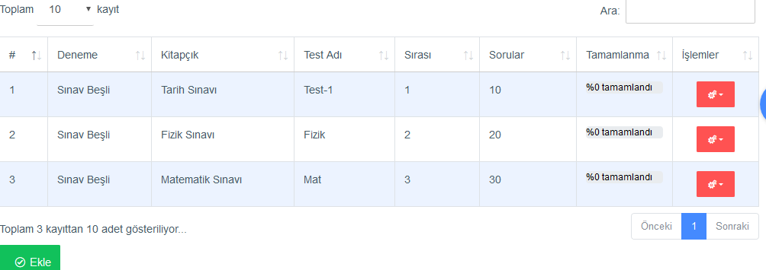
2.2.1.1.1-Booklet Tests
Add-Booklet Tests
**Select exam Set
**Select Booklet
**Add Test Name
**select Tests Lesson(Select multiple-more than one)
**what order in the tab menu( go to page 50 in the app screeen document, Tab menu course is booklet tests. in what order they will be sorted)

Slide 26
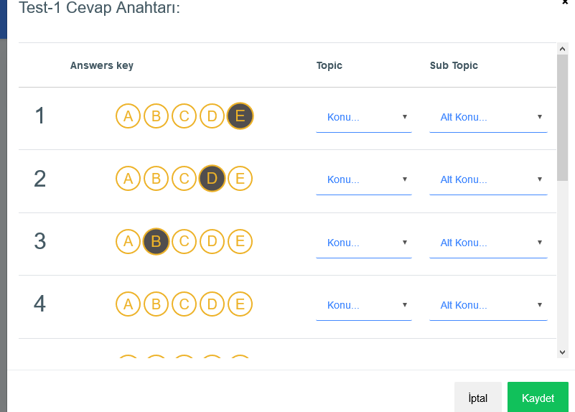
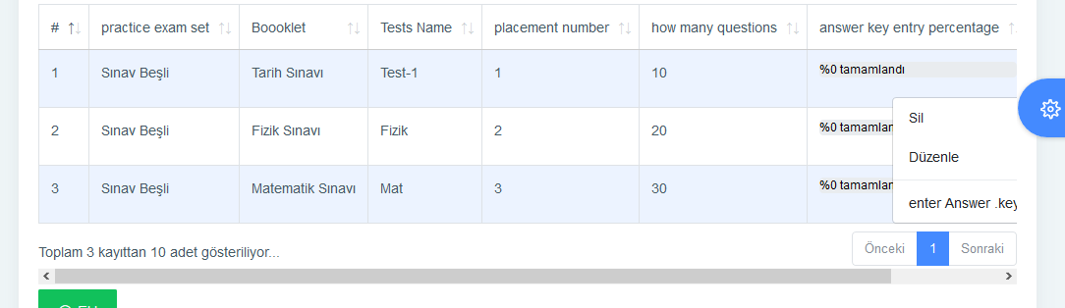
2.2.1.1.1-Booklet Tests Answer
Add-answers for boklet tests
**mark the correct answer for the question
**Select Topic
**Select Sub Topic
NOTE: the question belongs to which topics and sub-topic(previously selected the Lesson to which the test was linked. So the topics and subtopics shown here must be subtopics depending on the topics and topics flagged for testing.
topic and subtopic are also linked

Slide 27
3-Teacher Module
3-Teacher Module
3.3-Give homework
3.1-Create class
3.2-invitations
3.3.1-homework from the question bank
3.3.2-homectiwork from the Practice exams
3.3.3-homework check
3.3.4-student data
the teacher creates the class. The teacher becomes friends with his account. He gives homework to his friends. He checks homework and displays the student report.

Slide 28
3.1-Create class
3.1-Create class
the teacher creates a new class. Students become members of this class. teacher gives homework to class. Homework goes to all students who are members of the group.
**Clas Name
**Clas Description
**if the class will be hidden; Clas Code(to enroll in class)
**if class will be published, every student can see and join the class
**teacher can add student to a class by email address

Slide 29
3.2-invitations
3.2-invitations
If friendship occurs between teacher and student, teacher can see student data.
**student can send friend request to guide teacher. teacher can accept incoming friend request.
**if the teacher accepts requests; view the accepted student names and data on the students data screen

Slide 30
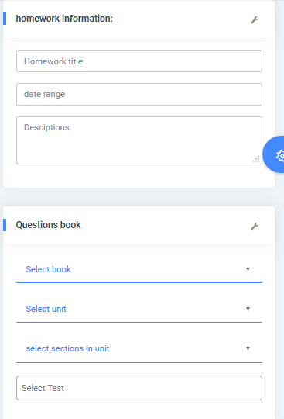
3.3.1-homework from the question bank
3.3.1-homework from the question bank
Selects Student or class- the teacher can give the student homework. this assignment can be a test in a question bank.
Add homework From questions bank
**Add Homework Title
**Add Deadline Date
**Add descriptions
**Select Questions Bank Book
**Select Unit
**Select Sections in uit
**Select Tests(Multiple select, select more than one)

Slide 31
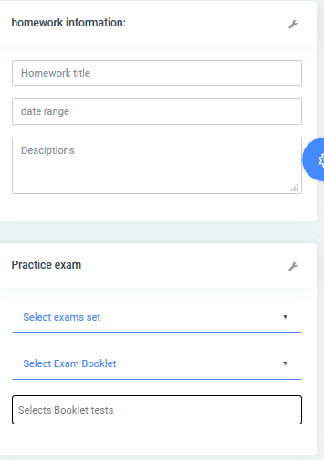
3.3.2-homectiwork from the Practice exams
3.3.2-homectiwork from the Practice exams
Selects Student or class- the teacher can give the student homework. this assignment can be a test in a exam sets
Add homework From Practices Exam
**Add Homework Title
**Add Deadline Date
**Add descriptions
**Select Exam Set
**Select Exam Booklet
**Select Booklet Tests(Multiple select, select more thane one)

Slide 32
3.3.3-homework check
3.3.3-homework check
the teacher checks the homework given to students or classes. sees the percentage of homework done

Slide 33
3.3.4-student data
3.3.4-student data
the teacher can view the analysis page that the student sees on the mobile screen. mobile analysis analysis screens are designed with flutter. Those screens can be harmonized with the web and used immediately here.

Slide 34
ROLE AND SORLE-PERMİSSİONS
Role and RolePermissions
Role
Permissions

Slide 35
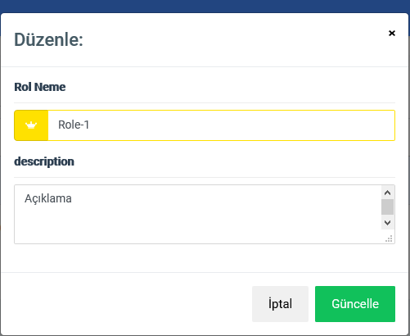
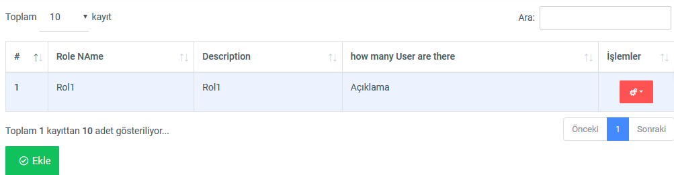
Role
Add-Role
**Add Role Name
**Add Description

Slide 36
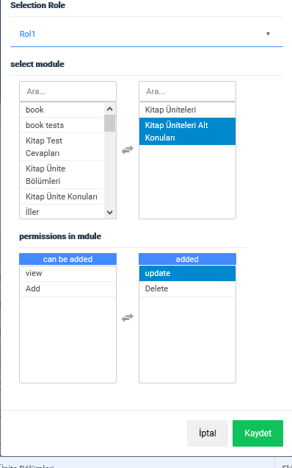
Permissions
Add-Role
**Select Role
**Select Module
**Select Permisions in module

Slide 37
ACCOUNTİNG MANAGEMENT
creating membership plans
Plans name
Plans description
plan price
date the plan will be valid
how many people bought the Plans?, who are the purchasers?
daily-monthly-yearly financial chart
daily-monthly-yearly active user chart
create a discount coupon

Slide 38
SUPPORT MANAGEMENT
students and teachers can post message.
messages from here are answered

Slide 39
USER-ADMİN MANAGEMENT
Students-Teacher-Admins are listed on separate pages
STUDENTS
TEACHERS
ADMİNS
listed with this information
Name-Surname-mail address-phone number-Role-plans purchased
Clicking on the name opens the profile page

Slide 40
Notifications And Announcements
announcements can be sent to all students or to a specific group
sending mass mail to all users or a group
sending bulk sms to all users or a group

Slide 41
SETTİNGS
maintaining website panels

